Slide 1
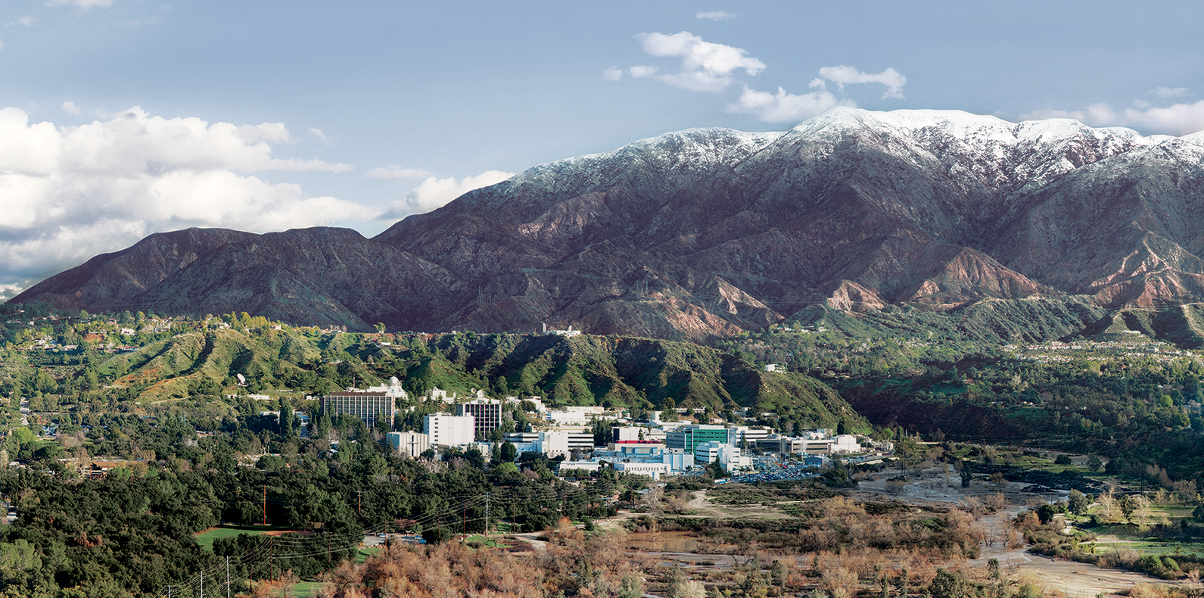
11. Optimal Estimation: Theory and Practice
Dr. David R. Thompson
Jet Propulsion Laboratory, Imaging Spectroscopy Group
July 20, 2019

Slide 2
Goals for this module
Apply Optimal Estimation to fit combined surface and atmosphere models
Construct new prior distributions
Correctly balance instrument and prior information

Slide 3
Global spectroscopy missions are an atmospheric correction challenge
Sequential methods face difficulties in certain observing conditions:
High water vapor
Extreme viewing angles
Surface/atmosphere coupling
Heavy aerosol loads
Orbital missions access tropical and subtropical environments that:
Host a large fraction of Earth’s productivity and biodiversity
Are underrepresented in atmospheric correction research
Often have “difficult” atmospheres
Most aerosol retrieval methods use dark or shadowed pixels that may not be apparent at orbital ground sampling resolutions
Existing methods generally disregard uncertainties, which are important to generalize existing regional studies to bias-free global maps

Slide 4
Optimal Estimation Theory: Simultaneous estimation of surface and atmosphere
A true spectroscopic retrieval that can exploit information distributed across the spectrum, helping to disentangle surface and atmosphere
A rigorous probabilistic formulation incorporates ancillary measurements via the prior distribution
Comprehensive uncertainty estimates can inform downstream analyses and global maps
Flexible state vectors, more robust for difficult observing conditions
Elegant, conceptually simple
Popularized for remote sensing by C. C. D. Rogers, e.g. his 2000 book
Notes:
Traditional atmospheric correction typically: (!) LUT generation of coefficients, (2) estimate of atmospheric state, (3) algebraic correction based on lambertian assumptions. Mature and effective; form basis of methods used in AVIRIS-NG standard products.
Several challenges to this…
limited size of state vector
Algebraic approximate solutions less accurate for extreme geometries
Uncoupled
Algebraic inversion means difficult to tease apart smooth atmospheric effects
Most inaccurate in regions of high haze, extreme water vapor causing absorption in scattering. India dataset contains pushes the frontier, excelelnt opportunity for investigating next level of precision.
Enabled by a fast radiative transfer model as an interior loop of an iterative max. a posteriori estimation

Slide 5
The “forward problem”
State vector
Forward model
Measurement
5

Slide 6
The “inverse problem”
Measurement
Inversion algorithm
Estimated state vector
6

Slide 7
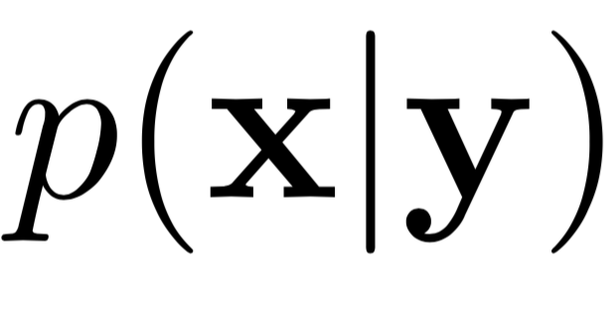
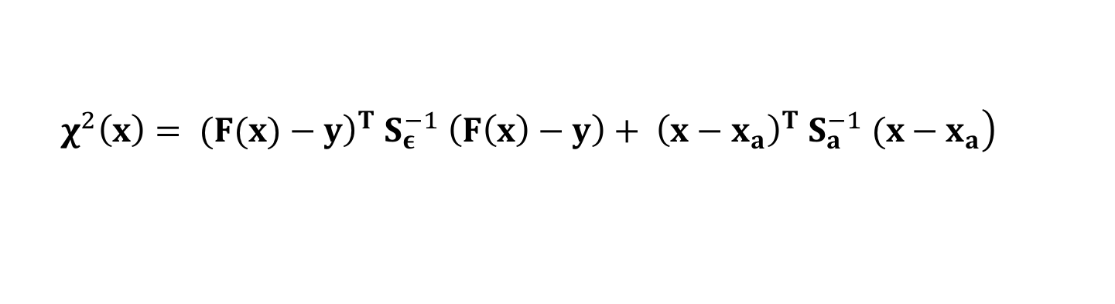
Maximum A Posteriori solution
Taking the logarithm of , and ignoring terms that are constant with , reduces the Maximum A Posteriori problem to the optimization:
… we can solve it by conjugate gradient descent.
$$\left.χ^{2}\left(x\right)= ({\left.F(x)−y\right)}^{T} S_{ε}^{−1} \left(F\left(x\right)−y\right)+ {\left(x−x_{a}\right)}^{T} S_{a}^{−1} (x−x_{a}\right)$$
Cost
Model match to measurement
Bayesian prior

Slide 8
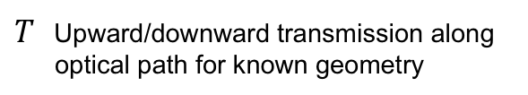
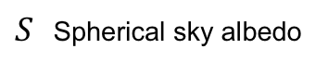
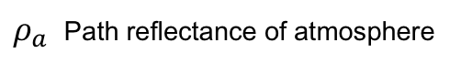
“Classic” atmospheric correction: a sequential operation
2. Analyze radiance to estimate this atmosphere (typically using band ratios).
3. Look up and/or interpolate optical coefficients
Surface reflectance
TOA reflectance
Lookup table indexed by H₂O, etc.
4. Algebraic Inversion
1. In advance, do RTM calculations for a grid of atmospheric conditions:
$ρ_{a}$ Path reflectance of atmosphere
$S$ Spherical sky albedo
$T$ Upward/downward transmission along optical path for known geometry
Notes:
With atmospheric state specified, We can get optical constants via linear lookup table interpolation (note: T=transmission, S=spherical sky albedo, rho_a is the path reflectance).
This is just one of several similar functional approximations to the actual radiative transfer solution. With atmosphere specified, we can invert it algebraically to recover the surface reflectance.
The conventional strategy is limited in sever

Slide 9
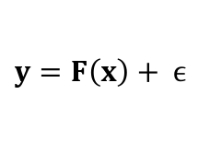
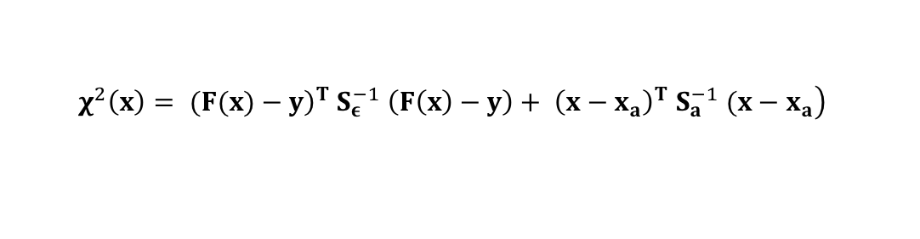
OE: Iterative simultaneous estimation of atmosphere and surface
1. Predict radiance
$y=F\left(x\right)+ ϵ$
2. Optimize state vector
$$\left.χ^{2}\left(x\right)= ({\left.F(x)−y\right)}^{T} S_{ε}^{−1} \left(F\left(x\right)−y\right)+ {\left(x−x_{a}\right)}^{T} S_{a}^{−1} (x−x_{a}\right)$$
Cost
Model match to measurement
Bayesian prior

Slide 10
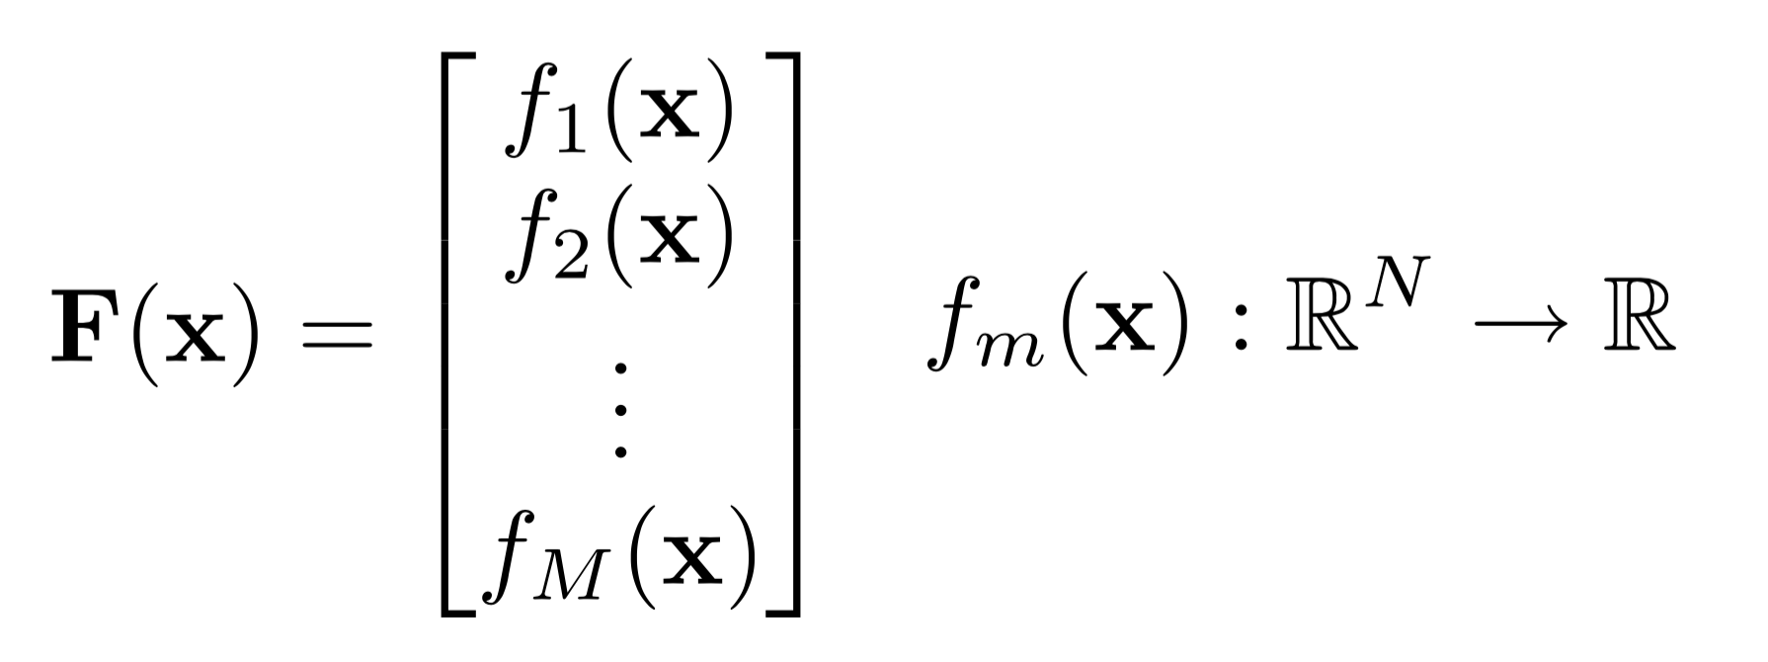
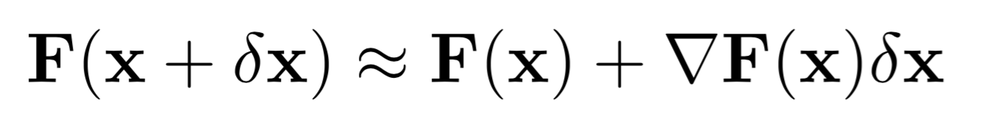
The Jacobian: The state’s influence on an observable
Elements of :
Consider the first order Taylor series expansion:
A local approximation, which is exact for linear problems

Slide 11
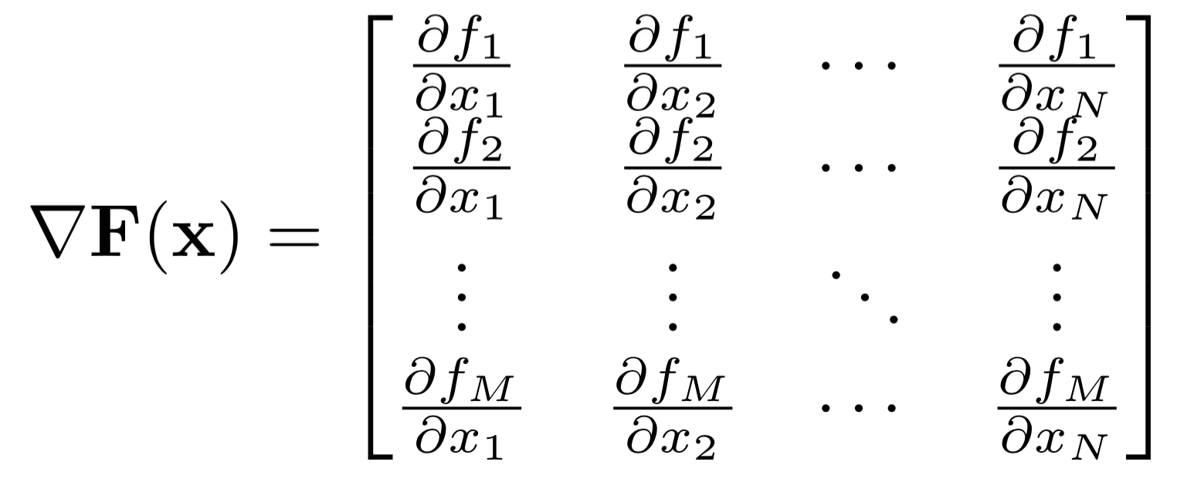
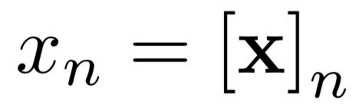
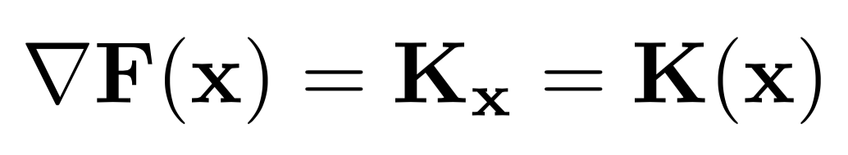
The Jacobian: The state’s influence on an observable
Written explicitly as:
where
A more compact form:

Slide 12
The Jacobian: The state’s influence on an observable
A single reflectance value
Atmospheric H₂O column

Slide 13
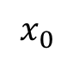

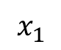

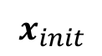
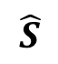
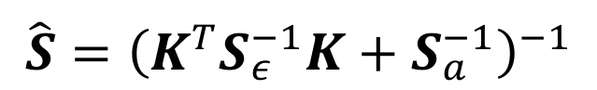
Posterior predictive uncertainty
$$\hat{S}={\left(K^{T}S_{ε}^{−1}K+S_{a}^{−1}\right)}^{−1}$$
$$p(x|y)$$
$$\hat{x}$$
$$\hat{S}$$
$$x_{init}$$
$$x_{0}$$
x_{ATMOS}
$$x_{1}$$
x_{SURFACE}

Slide 14
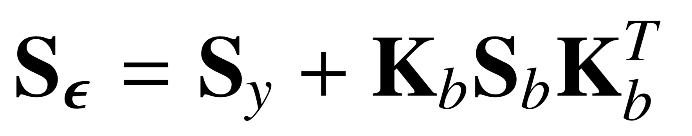
Variability due to measurement noise vs. unknown state parameters
Total observation noise
Jacobian WRT unknowns
Measurement noise (instrument effects)
Photon noise
Read noise
Dark current noise
Unknown parameters in the observation system
Sky view factor
H₂O absorption coefficient intensity
Systematic radiative transfer error
Uncorrelated radiative transfer error

Slide 15
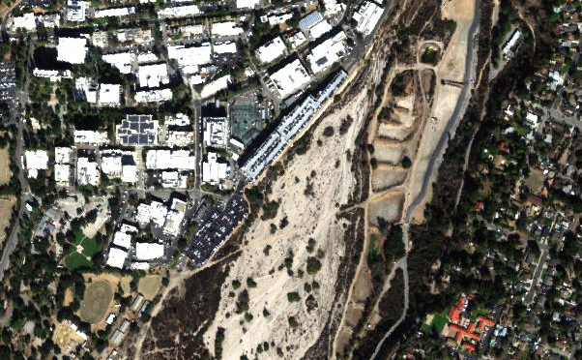
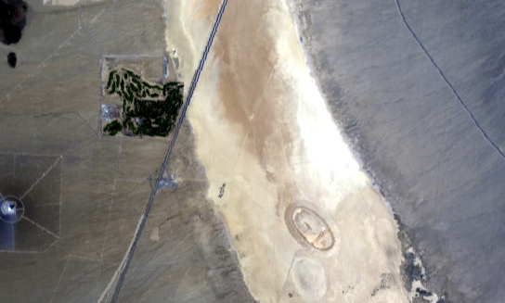
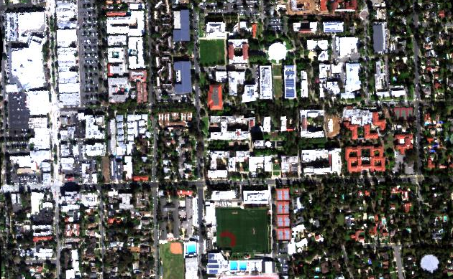
Case study [Thompson et al., Remote Sensing of Environment 218, 2018]
Jet Propulsion Laboratory
In-situ AOD via Reagan sunphotometers
In-situ surface reflectance via ASD Fieldspec
V
N
VI
100 m
Ivanpah Playa
California Institute of Technology
IV
I
N
N
II
100 m
1000 m
III
Notes:
We measured 6 sites at Ivanpah, JPL, and Caltech.

Slide 16

Model components
Instrument: AVIRIS-NG
Instrument model with Wavelength- and signal-dependent SNR
Photon shot & read noise
Uncorrelated calibration uncertainty
Systematic calibration / RT uncertainty
Atmosphere: MODTRAN 6.0 RTM
DISORT MS, Correlated-k
Rural aerosol model
broad prior uncertainties
Unmodeled unknowns, including H₂O absorption coefficients
H₂O, AOD retrieved
Surface: Multi-component Multivariate Gaussians
Prior based on universal library, highly regularized to permit accurate retrieval of arbitrary shapes
Reflectance estimated independently in every channel
Pre-defined
Statistical, fit to data
Retrieved in the inversion

Slide 17
Example of multi-component surface models
[Thompson et al., Remote Sensing of Environment 216, 2018]

Slide 18
Reflectance estimate vs. in situ [Thompson et al., Remote Sensing of Environment 2018]
Wavelength (nm)
Wavelength (nm)
Notes:
Good agreement!

Slide 19
Aerosol fitting results [Thompson et al., Remote Sensing of Environment, 232, 2019].
AOD550 estimates for AVIRIS-NG India campaign
Simultaneous estimation of surface and atmosphere parameters can account for aerosol distortions
We retrieve three optical types (best interpreted as structured error terms rather than physical particle properties)
Validation on a large segment of the AVIRIS-NG campaign in India, which experienced high water vapor and AOD loadings
Aerosol type
fractions
Aerosol type
fractions
Original
OE solution
Original method
New approach
Aerosol distortion
Aerosol-related H₂O vapor distortions
H₂O vapor distortions

Slide 20
Modeling assumptions affect the relative weighting of measurement and prior
Wavelength (nm)
[Thompson et al., Remote Sensing of Environment 216, 2018]

Slide 21
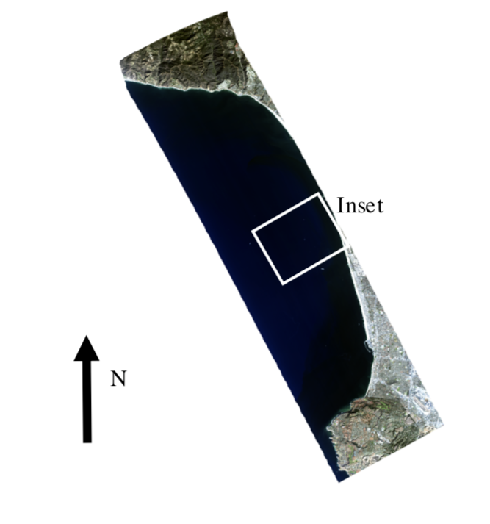
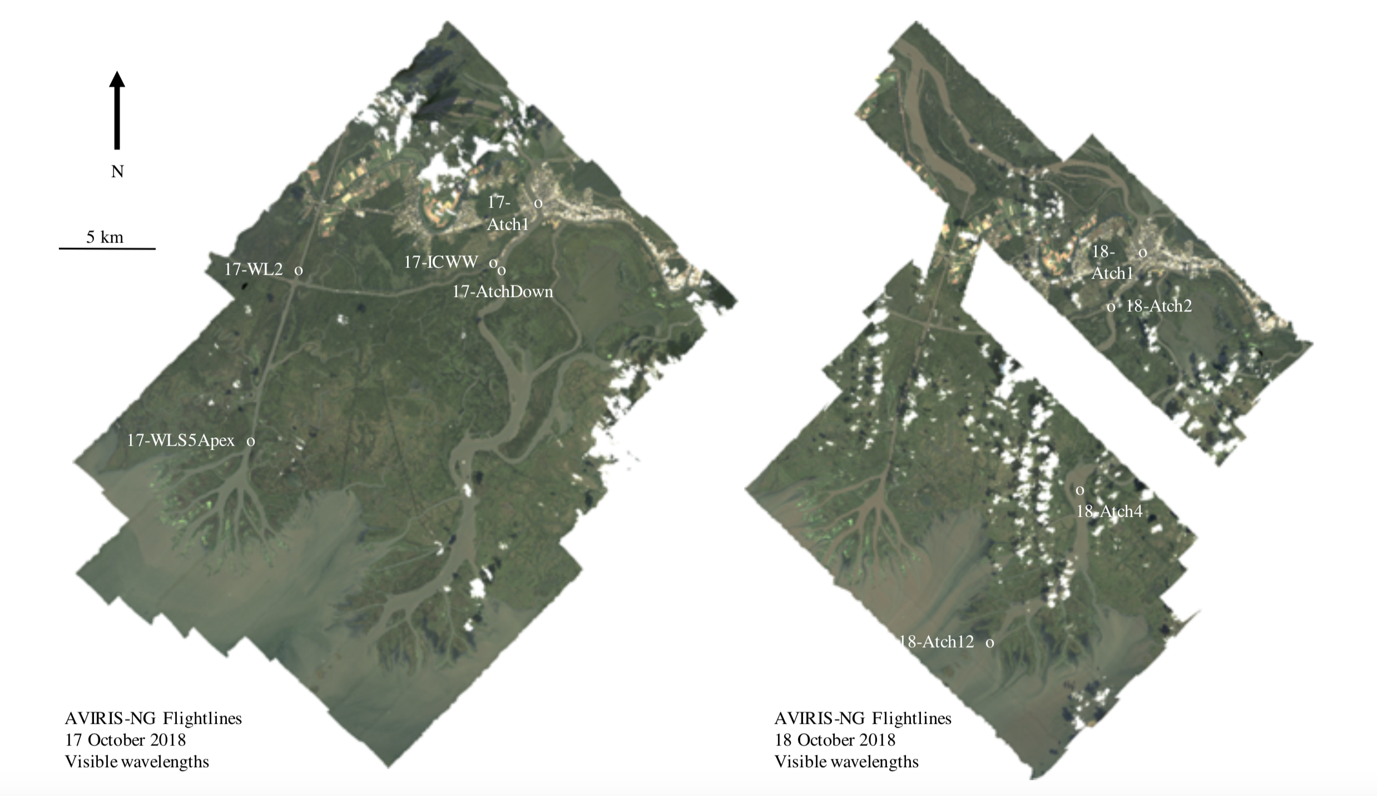
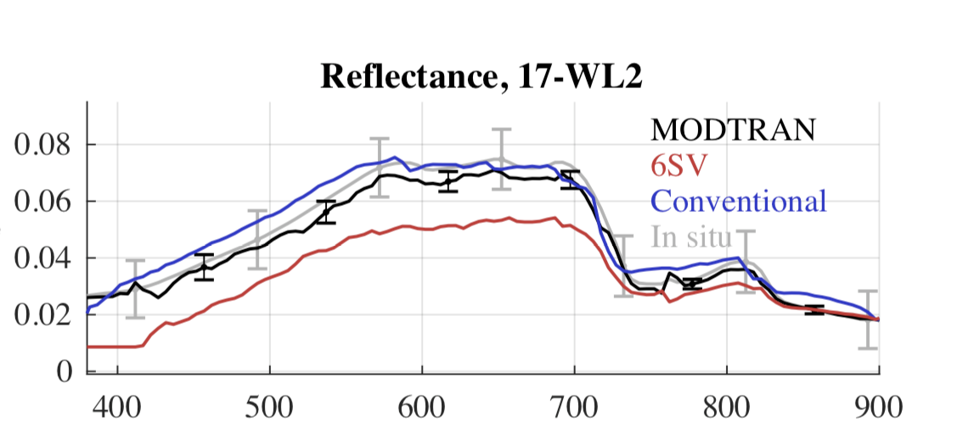
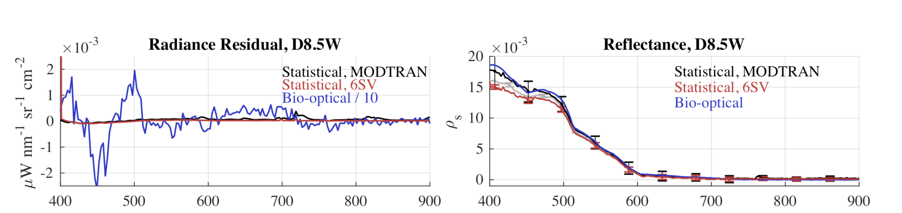
Coastal environments [Thompson et al., Remote Sensing of Environment 231, 2019]
Notes:
Posterior uncertainty predictions (grey envelopes) accurately predict and capture our actual discrepancies!
This demonstrates a closed account of the uncertainty in the system. To our knowledge, this is the first time it has been done for VSWIR imaging spectroscopy.
Note: we also account for the uncertainty in the surface measurement, which is a significant contributor to the confidence bands.

Slide 22
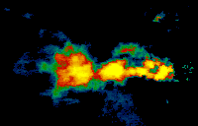
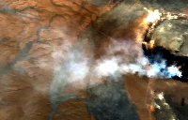
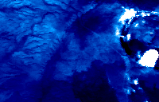
Example: volcano AOD observations
Combined estimate of H₂O vapor, AOT, surface reflectance and temperature
[Realmuto, Thompson, et al., in preparation]
Aerosol Optical Depth at 550 nm
Hot crater
AVIRIS-C f170127t01p00r16
(subset, visible bands)
Aerosol Optical Depth Uncertainty

